Slide 1
CS 105: Data Gathering

Slide 2
Outline
What is Web Crawling?
How to build a web crawler
Scrappy – off the shelf web-crawler
Data gathering using APIs

Slide 3
What is Web Crawling?
A Web crawler, sometimes called a spider, is a bot that systematically browses the WWW (by following a link from one page to another) to perform Web indexing (learn about web-pages and the graph network) and to scrape data from websites.
A Web scraper is a specialized tool designed to accurately and quickly extract data from a web page.
So the difference is that the web-crawler locates web-pages, and a scraper simply extracts the content of interest from a given page.

Slide 4
Basic crawler operation
Begin with known “seed” URLs
Fetch and parse them
Extract URLs they point to
Place the extracted URLs on a queue
Fetch each URL on the queue and repeat

Slide 5

Crawling picture
URLs crawled
and parsed
Unseen Web
Seed
pages
URLs frontier
Web

Slide 6
Challenges faced when building a crawler
Web crawling isn’t feasible with one machine
Must build a robust distributed web-crawler
Robust to malicious pages
Spam pages
Spider traps
Be immune to spider traps and other malicious behavior from web servers
Even non-malicious pages pose challenges
Latency/bandwidth to remote servers vary
Webmasters’ stipulations
How “deep” should you crawl a site’s URL hierarchy?
A
B
C

Slide 7
What any crawler must do
Avoid crawling duplicate pages / URLs
Duplicates can imply duplicate URLs that can be collected from the distributed set of machines that
Be Polite: Respect implicit and explicit politeness considerations
Only crawl allowed pages
Respect robots.txt (more on this shortly)

Slide 8
What any crawler should do
Be capable of distributed operation: designed to run on multiple distributed machines
Be scalable: designed to increase the crawl rate by adding more machines
Performance/efficiency: permit full use of available processing and network resources
Fetch pages of “higher quality” first
Continuous operation: Continue fetching fresh copies of a previously fetched page

Slide 9
Updated crawling picture
URLs crawled
and parsed
Unseen Web
Seed
Pages
URL frontier
Crawling thread

Slide 10
Explicit and implicit politeness
What is URL frontier?
Can include multiple pages from the same host
Must avoid trying to fetch them all at the same time
Explicit politeness: specifications from webmasters on what portions of site can be crawled
robots.txt
Implicit politeness: even with no specification, avoid hitting any site too often

Slide 11
Robots.txt
Protocol for giving spiders (“robots”) limited access to a website, originally from 1994
www.robotstxt.org/wc/norobots.html
Website announces its request on what can(not) be crawled
For a server, create a file /robots.txt
This file specifies access restrictions

Slide 12
Robots.txt example
No robot should visit any URL starting with "/yoursite/temp/", except the robot called “searchengine":
User-agent: *
Disallow: /yoursite/temp/
User-agent: searchengine
Disallow:

Slide 13
Processing steps in crawling
Pick a URL from the frontier
Fetch the document at the URL
Parse the URL
Extract links from it to other docs (URLs)
Check if URL has content already seen
If not, add to indexes
For each extracted URL
Ensure it passes certain URL filter tests
Check if it is already in the frontier (duplicate URL elimination)

Slide 14
Basic crawl architecture
WWW
DNS
Doc
FP’s
robots
filters
URL
set
Parse
Fetch
Content
seen?
URL
filter
Dup
URL
elim
URL Frontier

Slide 15
Content seen?
Duplication is widespread on the web
If the page just fetched is already in the index, do not further process it
This is verified using document fingerprints or shingles

Slide 16
Distributing the crawler
Run multiple crawl threads, under different processes – potentially at different nodes
Geographically distributed nodes
Partition hosts being crawled into nodes
Hash used for partition
How do these nodes communicate and share URLs?

Slide 17
Communication between nodes
Sec. 20.2.1
Output of the URL filter at each node is sent to the Dup URL Eliminator of the appropriate node
WWW
DNS
To
other
nodes
URL
set
Parse
Doc
FP’s
robots
filters
Fetch
Content
seen?
URL
filter
Host
splitter
Dup
URL
elim
From
other
nodes
URL Frontier

Slide 18
URL frontier: two main considerations
Politeness: do not hit a web server too frequently
Freshness: crawl some pages more often than others
E.g., pages (such as News sites) whose content changes often
These goals may conflict each other.
(E.g., simple priority queue fails – many links out of a page go to its own site, creating a burst of accesses to that site.)

Slide 19
URL frontier: Mercator scheme
URLs flow in from the top into the frontier
Front queues manage prioritization
Back queues enforce politeness
Each queue is FIFO
URLs
Prioritizer
K front queues
Biased front queue selector
Back queue router
B back queues
Single host on each
Back queue selector
Crawl thread requesting URL

Slide 20
Front queues
Prioritizer
1
K
Biased front queue selector
Back queue router

Slide 21
Sitemaps
Sitemaps contain lists of URLs and data about those URLs, such as modification time and modification frequency
Generated by web server administrators
Tells crawler about pages it might not otherwise find
Gives crawler a hint about when to check a page for changes

Slide 22
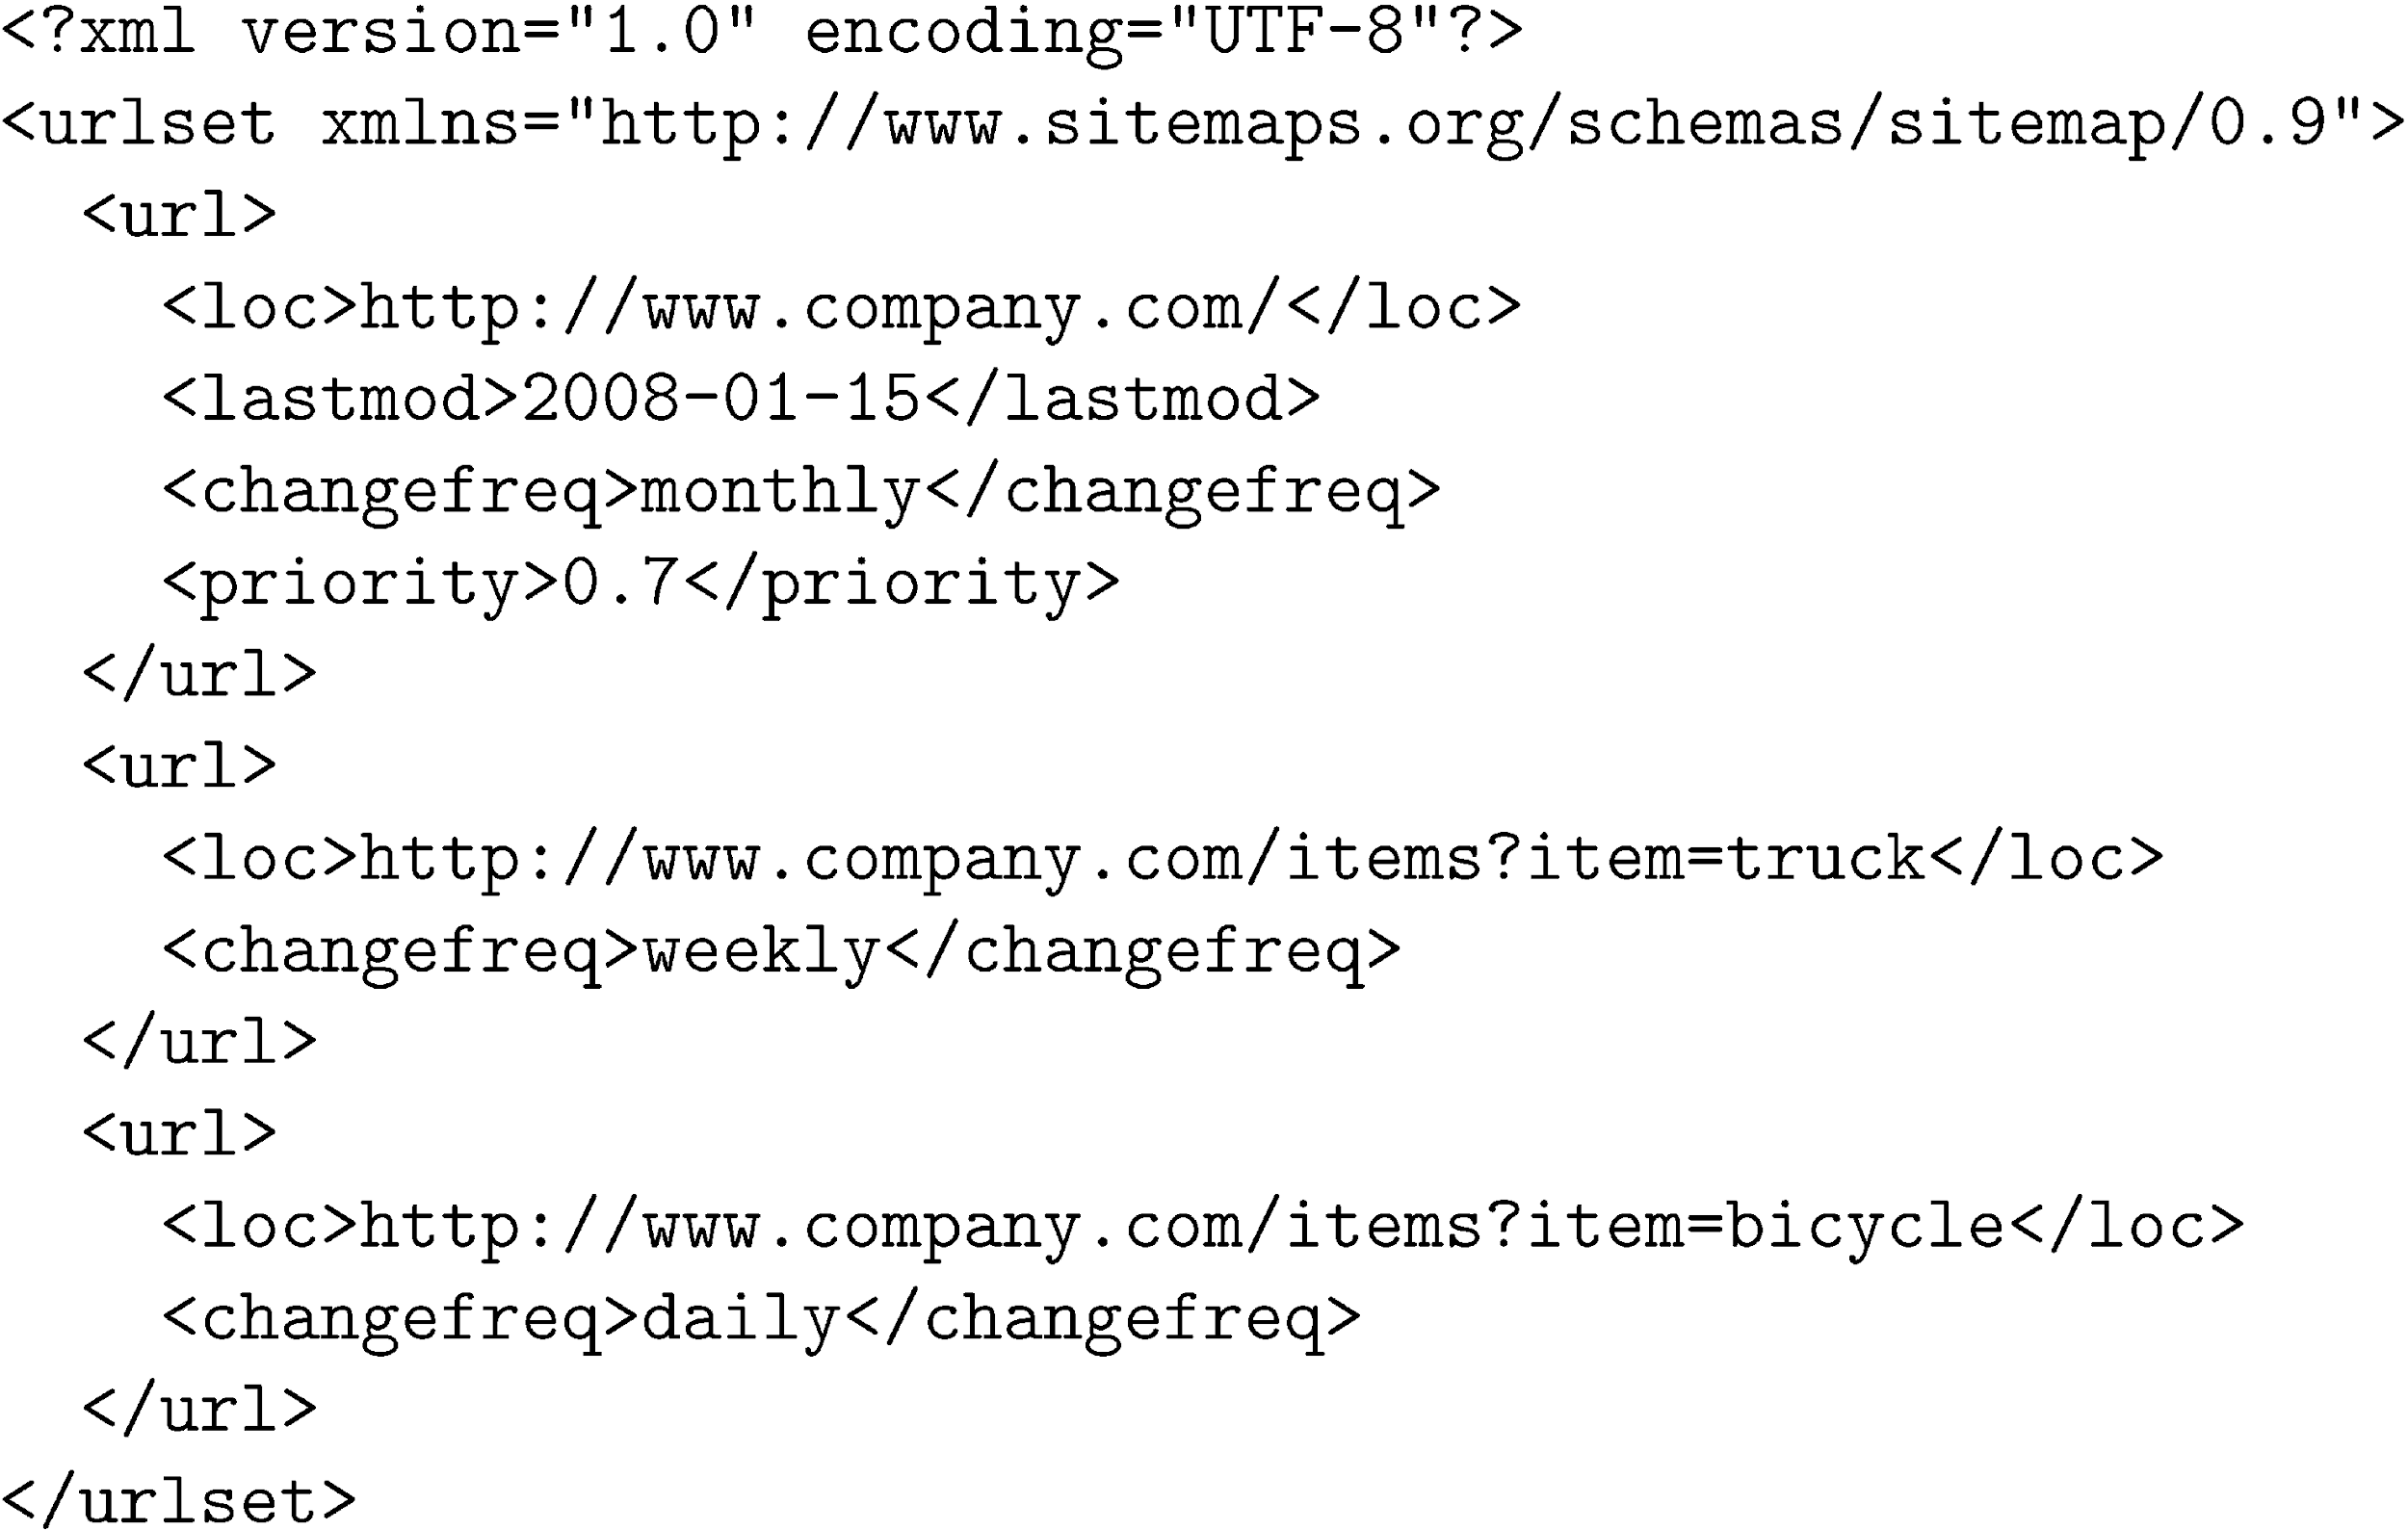
Sitemap Example

Slide 23
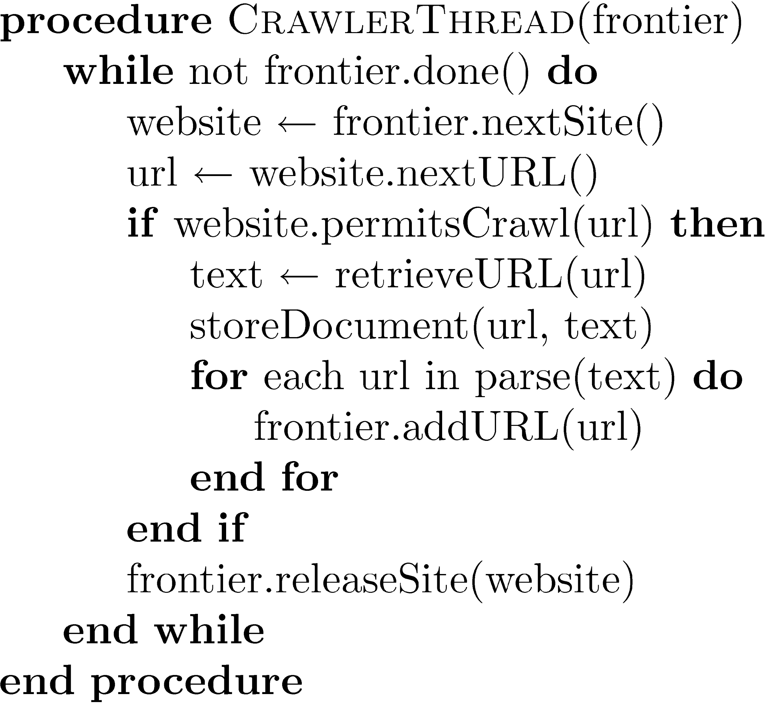
Simple Crawler Thread

Slide 24
Freshness
Web pages are constantly being added, deleted, and modified
Web crawler must continually revisit pages it has already crawled to see if they have changed in order to maintain the freshness of the document collection
stale copies no longer reflect the real contents of the web pages

Slide 25
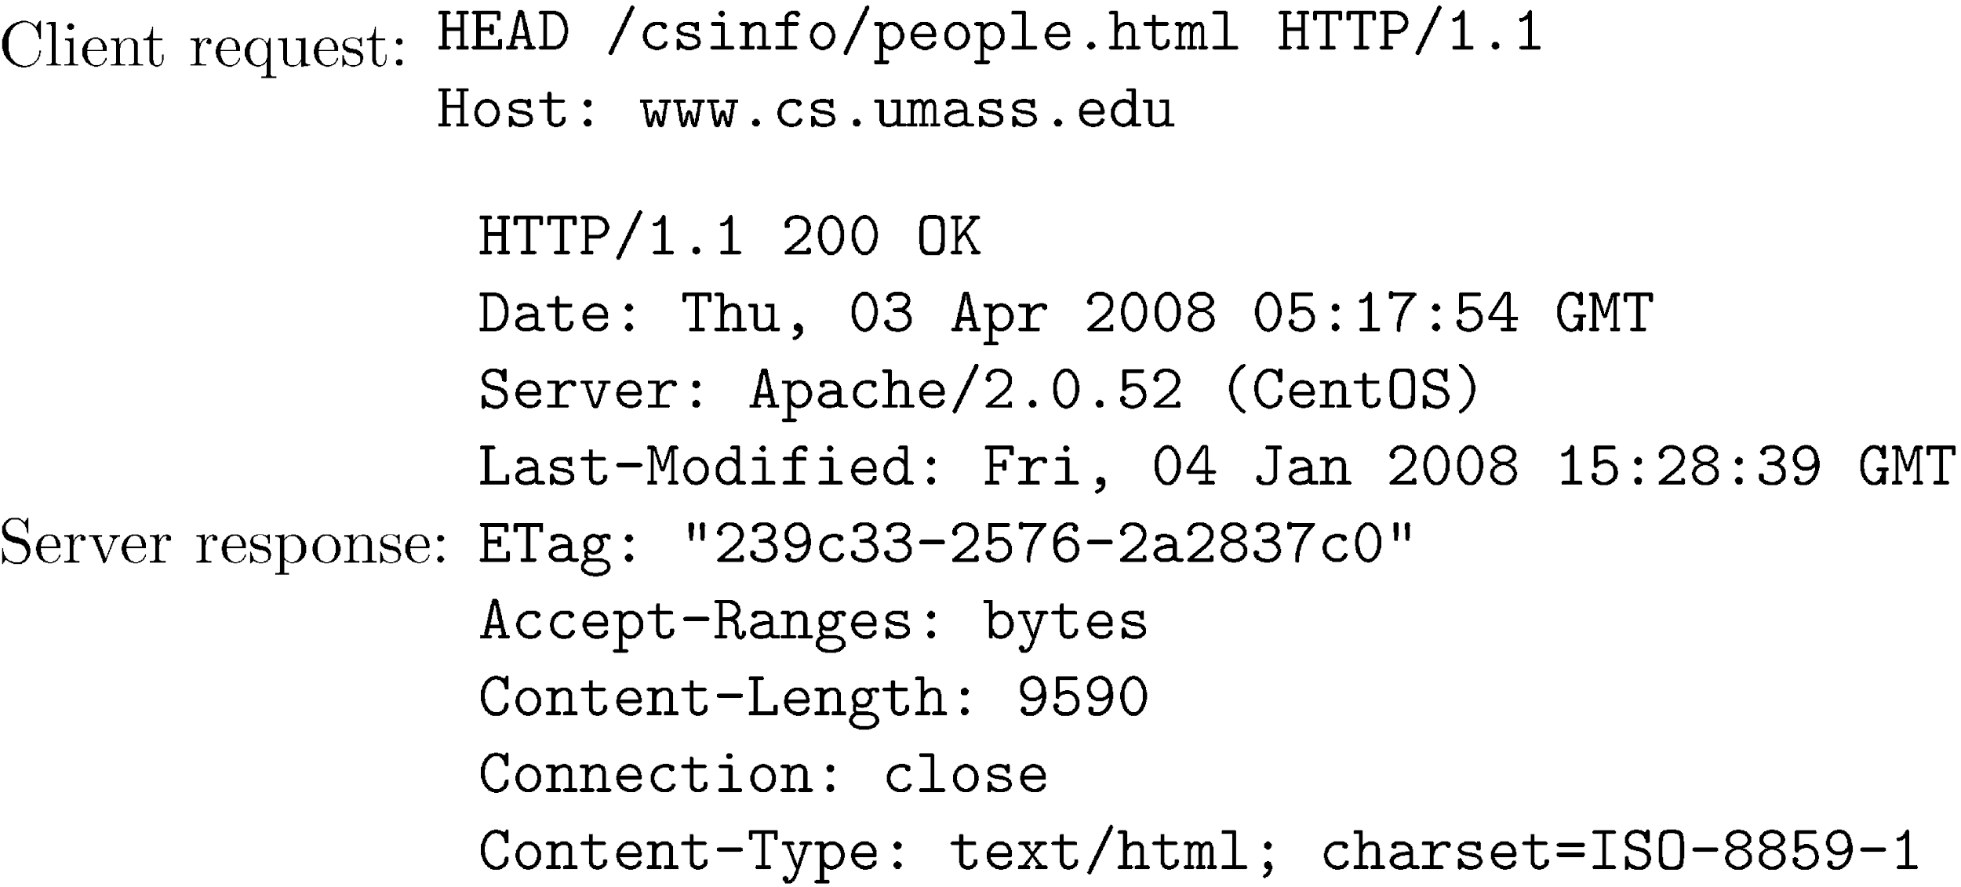
Freshness
HTTP protocol has a special request type called HEAD that makes it easy to check for page changes
returns information about page, not page itself

Slide 26

1) Scrapy
Open source web spider written in Python
2) PySpider
3) MechanicalSoup + BeautifulSoup

Slide 27
What is Scrapy
Scrapy is a open source and collaborative framework for crawling the web
Scrapy is an excellent choice for focused crawls
Scrapy is generally faster than other open source crawlers
Scrapy is written in Python
Scrapy is written in pure Python and depends on a few key Python packages (among others):
lxml, an efficient XML and HTML parser
parsel, an HTML/XML data extraction library written on top of lxml,
w3lib, a multi-purpose helper for dealing with URLs and web page encodings
twisted, an asynchronous networking framework
cryptography and pyOpenSSL, to deal with various network-level security needs
Tutorial: https://docs.scrapy.org/en/latest/intro/install.html#intro-install

Slide 28
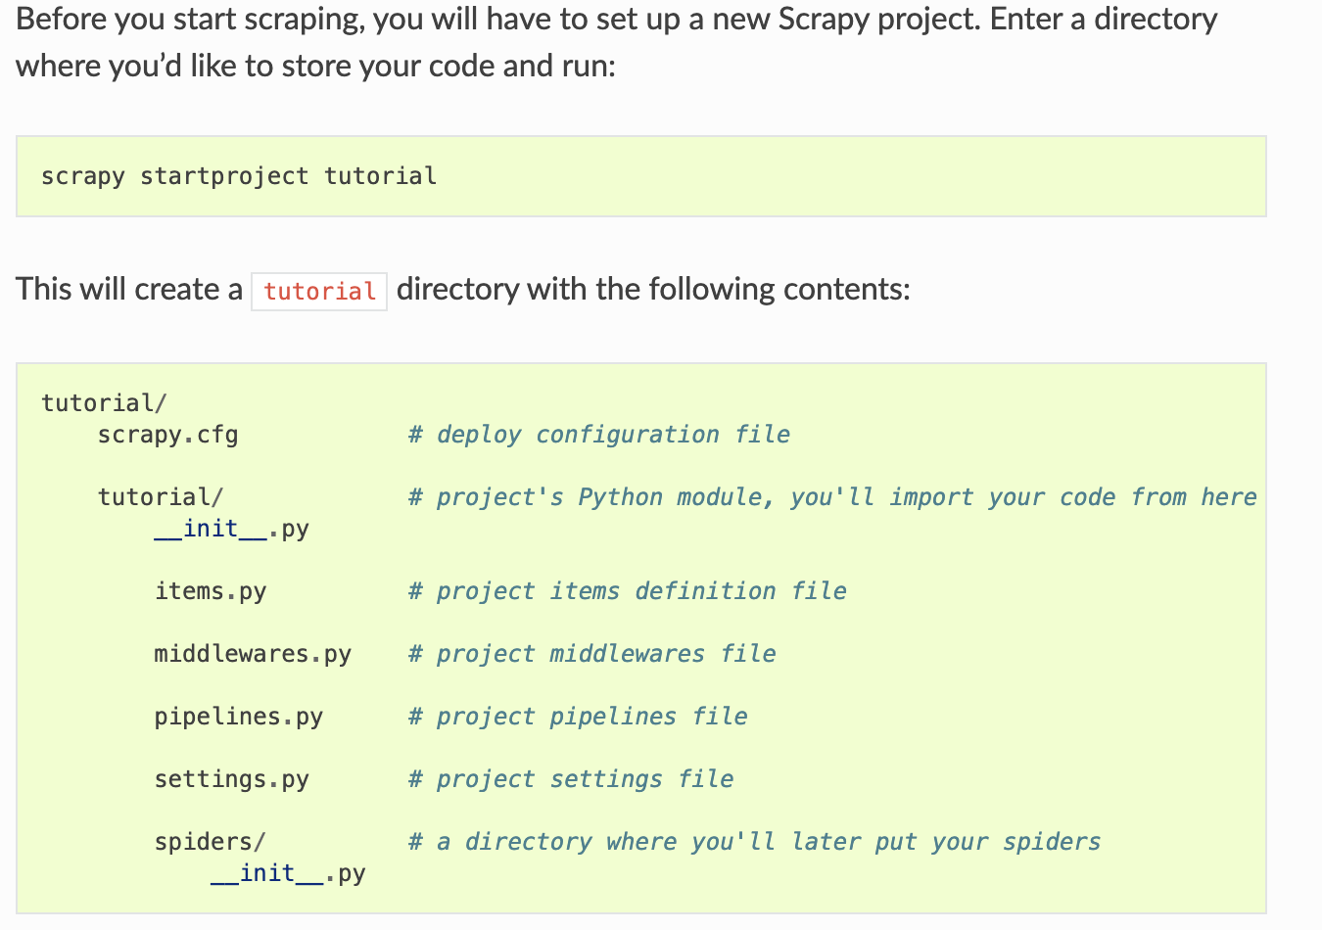
We write our spiders in this directory

Slide 29
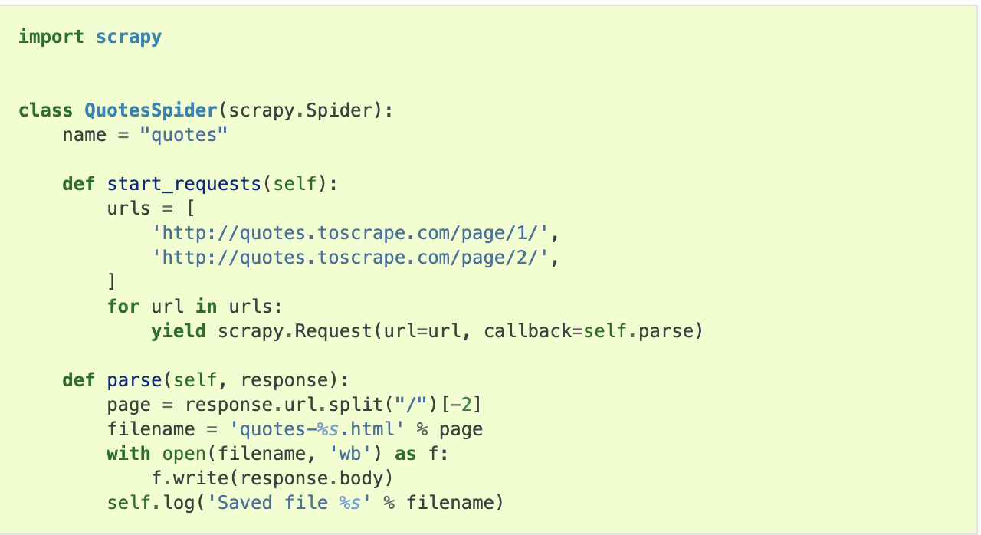
Spiders are classes that you define and that Scrapy uses to scrape information from a website (or a group of websites). They must subclass Spider and define the initial requests to make, optionally how to follow links in the pages, and how to parse the downloaded page content to extract data.

Slide 30
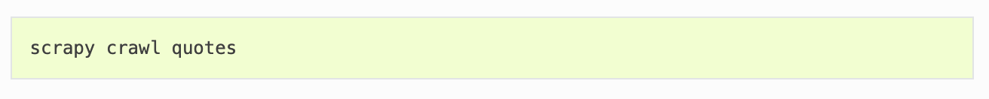
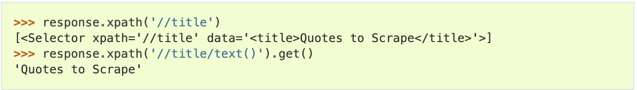
Run the spider by going to the project top level directory and run
The next step is to write code to extract select content from the page.
This is accomplished by selecting elements using CSS, or Xpath
XPath is a expression that allows you to select elements based on structure as well as content.

Slide 31
Other ways to acquire data
In some cases, companies make their data and functionality available via APIs.
What is an API?
Formally, Application Programming Interface (API) is a specification intended to be used as an interface by software components to communicate with each other.
Consumer Program
API
Provider
Program

Slide 32
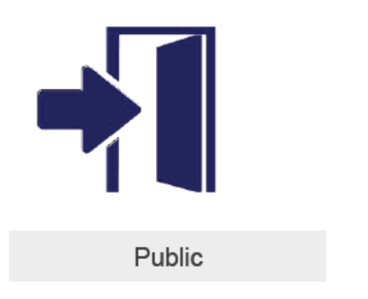


A bit about APIs
Private APIs are used internally to facilitate the integration of different applications and systems used by a company.
Partner APIs are used to facilitate communication and integration of software between a company and its business partners.
Public APIs allow companies to publicly expose information and functionalities of one or various systems and applications to third parties that do not have a relationship.
Ex. Release data so developers can create an app

Slide 33
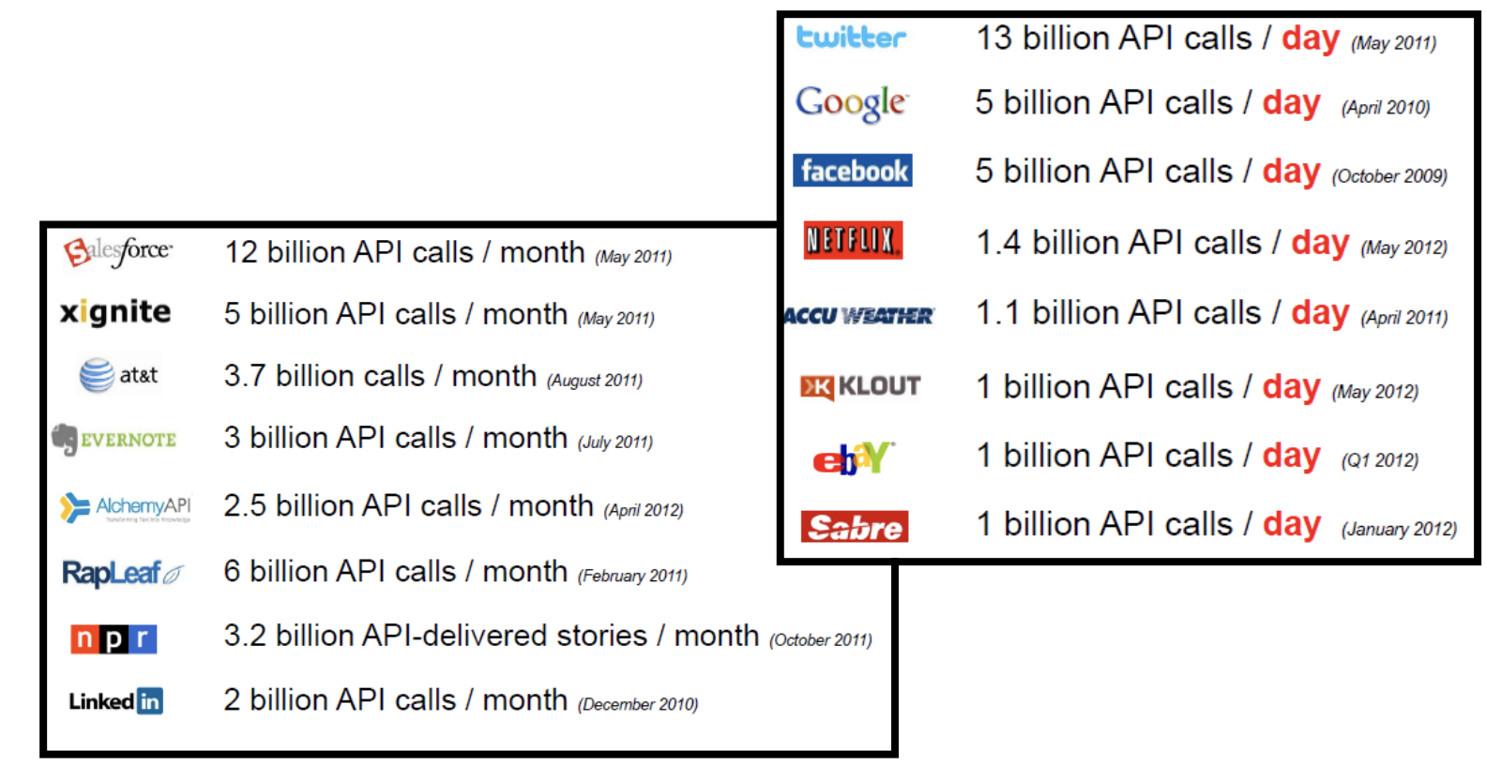
Extensive use of APIs

Slide 34
How to use an API
APIs consist of three parts:
User: the person who makes a request
Client: the computer that sends the request to the server
Server: the computer that responds to the request
APIs offer endpoints to obtain, change, or delete data
There are four types of actions an API can take:
GET: requests data from a server — can be status or specifics (like last_name)
POST: sends changes from the client to the server; think of this as adding information to the server, like making a new entry
PUT: revises or adds to existing information
DELETE: deletes existing information
Consumer Program
API
Provider
Program

Slide 35
How to use an API
Well, you need to read the documentation for the particular API you are interested in.
Most APIs require an API key. Once you find an API you want to play with, look in the documentation for access requirements.
The easiest way to start using an API is by finding an HTTP client online, like REST-Client, Postman, or Paw. These ready-made (and often free) tools help you structure your requests to access existing APIs with the API key you received.
Once you pull data from the API, understand the format of the data (XML or JSON) and how to extract the data of interest.

